Slide 1
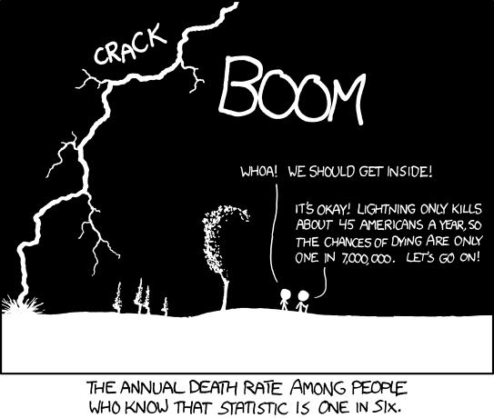
Conditional Probability
http://stats.stackexchange.com/questions/
423/what-is-your-favorite-data-analysis-cartoon

Slide 2
4.4/4.5: Conditional Probability and Independence - Goals
Be able to calculate conditional probabilities.
Apply the general multiplication rule.
Use Bayes rule (or tree diagrams) to find probabilities.
Determine if two events with positive probability are independent.
Understand the difference between independence and disjoint.

Slide 3
Formulas
Conditional Probability:
$P\left(B | A\right)=\frac{P(A∩B)}{P(A)}$
General multiplication rule:
P(A ∩ B) = P(A) P(B|A)
Bayes’ Rule
$\text{P}\left(\text{A} | \text{B}\right)\text{=}\frac{\text{P}\left(\text{B} | \text{A}\right)\text{P}\text{(}\text{A}\text{)}}{\text{P}\left(\text{B} | \text{A}\right)\text{P}\left(\text{A}\right)\text{+}\text{P}\left(\text{B} | {\text{A}}^{\text{′}}\right)\text{P}\text{(}{\text{A}}^{\text{′}}\text{)}}$

Slide 4
Law of Total Probability
5
1
4
6
3
B and 4
B and 6
B and 3
B and 7
2
7
B

Slide 5
Independence
Two events are independent if knowing that one occurs does not change the probability that the other occurs.
If A and B are independent:
P(B|A) = P(B)
P(A ∩ B) = P(A) P(B)

Slide 6
Disjoint vs. Independent
In each situation, are the following two events
a) disjoint and/or b) independent?
Draw 1 card from a deck
A = card is a heart B = card is not a heart
Toss 2 coins
A = Coin 1 is a head B = Coin 2 is a head
Roll two 4-sided dice.
A = red die is 2 B = sum of the dice is 3

Slide 7
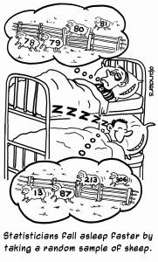
Chapter 5: Random Variables and Discrete Probability Distributions
http://www.landers.co.uk/statistics-cartoons/

Slide 8
5.1-5.2: Random Variables - Goals
Be able to define what a random variable is.
Be able to differentiate between discrete and continuous random variables.
Describe the probability distribution of a discrete random variable.
Use the distribution and properties of a discrete random variable to calculate the probability of an event.

Slide 9
Random Variables
A random variable is a function that assigns a unique numerical value to each outcome in a sample space.
Random variables can be discrete or continuous.
The probability distribution of a random variable gives its possible values and their probabilities.

Slide 10
Probability Distribution of a Random Variables
Probability mass function (pmf) is the probability that a discrete random variable is equal to some specific value.
In symbols, p(x) = P(X = x)
Properties
0 ≤ p_{i} ≤ 1
$$2. \sum_{i}{p_{i}(x)}=1$$

Slide 11
Expected Value and Variance for Random Variables
$$E\left(X\right)=μ=μ_{X}=\sum_{i}{x_{i}p_{i}}$$
$$Var\left(X\right)=σ^{2}=σ_{X}^{2}$$
$$=E\left[{\left(X−μ_{X}\right)}^{2}\right]=\sum{{(x_{i}−μ_{X})}^{2}∙p_{i}}$$
= E(X²) – (E(X))²
$$σ_{X}=\sqrt{Var(X)}$$

Slide 12
Rules for Expected Value and Variance
Means
Rule 1: µ_{a+bX} = a + bµ_{X}
Rule 2: µ_{X±Y} = µ_{X} ± µ_{Y}
Rule 3:$E\left(g\left(X\right)\right)=\sum{g\left(x\right)p(x)}$
Variance
Rule 1: σ²_{a+bX} = b²σ²_{X}
Rule 2: If X and Y are independent random variables, then: σ²_{X±Y} = σ²_{X} + σ²_{Y}
Rule 3: If X and Y have correlation ρ,
then: σ²_{X±Y} = σ²_{X} + σ²_{Y} ± 2ρσ_{X}σ_{Y}

